Slide 1
Does Social Media Affect Mental Health?
Master’s in Data Analytics – Winter 2025 (Predictive Analytics, DAMO-510-3)

Slide 2
Group Members!
Mohammed Imran Khan, Chittanoori Manish, Mounika Ravella, Mahvish Kounain

Slide 3
Table of contents
01
02
04
05
07
03
Introduction and Objectives
Dataset and Methodology
Data Preprocessing
Exploratory Data Analysis (EDA)
06
08
Statistical Analysis
Business & Ethical Implications
Challenges and Considerations
Conclusion and Recommendations

Slide 4
01
Introduction & Objectives

Slide 5
Introduction & Background
Social media influences daily activities, emotions, and mental well-being. This study examines how social media habits impact mental health indicators such as stress, sleep, and self-esteem.
Objectives:
Assess the impact of daily social media use on mental well-being.
Identify patterns of compulsive usage & validation-seeking behavior.
Determine correlations between social media habits & mental health symptoms.
Analyze how social comparison influences self-perception and anxiety.

Slide 6
Dataset & Methodology
02

Slide 7
Dataset & Methodology
Dataset: Kaggle dataset with 481 responses, 21 features.
Data Includes:
Social Media Habits: Platforms used, time spent, purposeless scrolling.
Mental Health Indicators: Restlessness, anxiety, sleep problems, depression.
Demographics: Age, gender, relationship status, occupation.
Methodology:
Data Collection: Gathered from Kaggle survey responses.
Data Preprocessing: Cleaned missing values and prepared features for analysis.
Exploratory Analysis: Identified trends and correlations in social media behavior.
Statistical Evaluation: Used descriptive statistics and correlation analysis.

Slide 8
Data Preprocessing
03

Slide 9
Data Preprocessing
Handling Missing Data:
MCAR test performed to check missing values.
Missing values replaced using mode imputation.
Outlier Detection:
Boxplots used to detect extreme values in mental health indicators.
Correlation Analysis:
Identified relationships between social media usage & mental health symptoms.

Slide 10
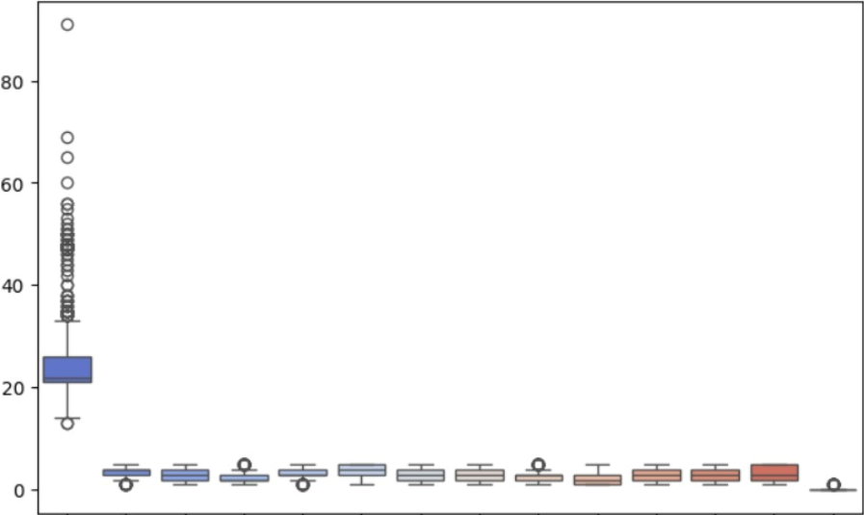
Box Plot for Outlier Detection

Slide 11
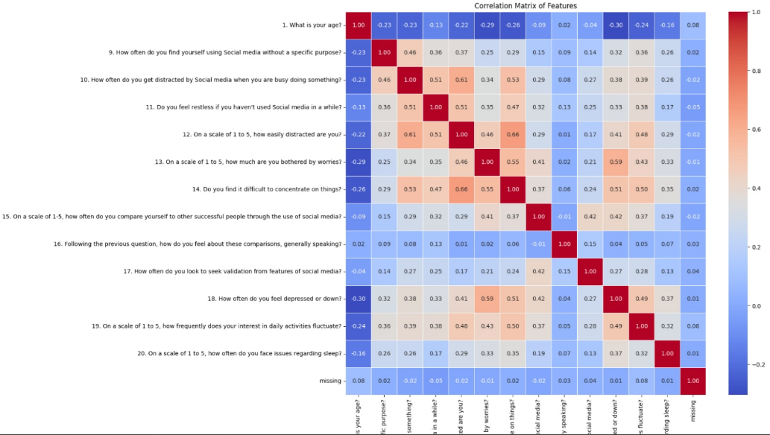
Correlation Analysis

Slide 12
04
Exploratory Data Analysis (EDA)

Slide 13
Category | Metric | Mean score | Interpretation
Social Media Usage & Distraction | Frequent Usage & Distraction | 3.32 / 5 | Frequent usage is linked to increased distraction.
 | Easily Distracted | 3.34 / 5 | Users struggle to maintain focus due to social media.
Compulsive Social Media Usage | Compulsive Usage | 3.55 / 5 | Many users browse social media without a specific purpose.
 | Restlessness | 2.58 / 5 | Some users feel restless when not using social media.
Mental Health Symptoms | Depression | 3.25 / 5 | Frequent low mood reported by many respondents.
 | Sleep Issues | 3.20 / 5 | Sleep disturbances are common among users.
Social Comparison and Validation Seeking | Social Comparison | 2.83 / 5 | Many users compare themselves to others.
 | Validation Seeking | 2.45 / 5 | Some actively seek social validation online.

Slide 14
Key Insights:
Higher social media usage correlates with distraction, restlessness, and sleep difficulties.
Frequent social comparison is linked to self-doubt and anxiety.
Individuals who engage in validation-seeking behaviors experience greater emotional fluctuations.

Slide 15
05
Statistical Analysis

Slide 16
Linear Regression Findings:
The results suggest that the linear regression model moderately explains the relationship between social media score and impact score. The R² score of 0.5559 indicates that about 56% of the variation in the impact score can be explained by the social media score. The positive coefficient (0.6777) suggests a positive correlation, meaning as social media scores increase, impact scores are likely to increase as well. While the model captures some meaningful trends, the remaining unexplained variation indicates that other factors may also play a significant role.

Slide 17
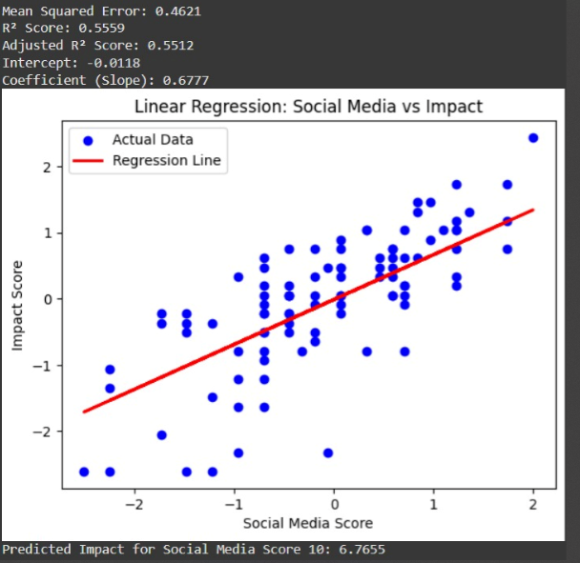
Linear Regression

Slide 18
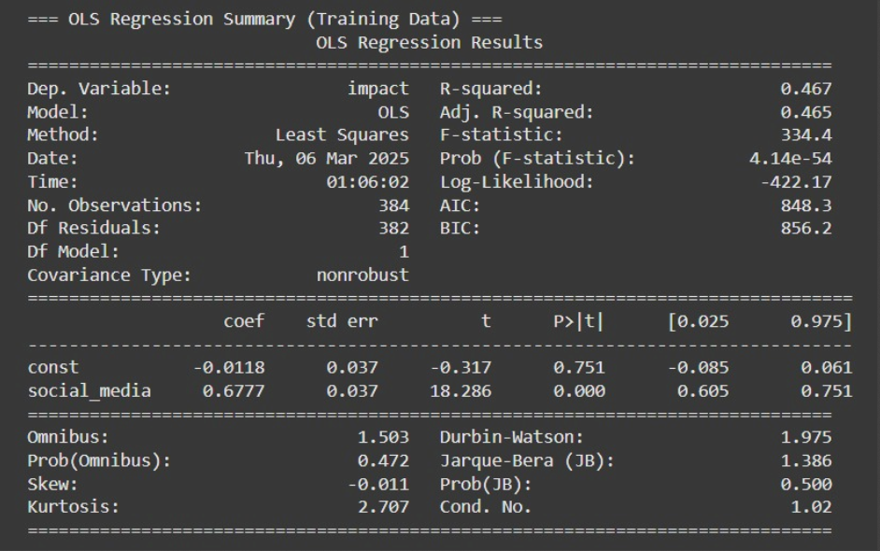

Slide 19
Key Insights:
Increased social media engagement → Lower sleep quality & emotional instability
Validation-seeking behavior → Linked to self-doubt & mental health concerns
Frequent online comparisons → Elevated stress levels & reduced well-being

Slide 20
Business & Ethical Implications
06

Slide 21
Business Applications (🔵) | Ethical Concerns (🔴)
📲 Responsible Usage → Platforms can introduce features limiting excessive use. | 🔐 Data Privacy → GDPR compliance & responsible AI practices.
🏫 Awareness Programs → Schools & workplaces should promote mental health education. | 🤖 AI Should Assist, Not Replace → AI tools should not replace professional evaluations.

Slide 22
07
Challenges & Considerations

Slide 23
📊 Dataset Size → 481 responses provide value, but larger samples improve accuracy.
🧠 Self-Reported Data → Individual perceptions vary, yet offer real-world insights.
Challenges and Considerations
🔍 Feature Scope → Text-based sentiment analysis could add depth.

Slide 24
08
Conclusion & Recommendations

Slide 25
✅ Key Takeaways | 💡 Recommendations
🧠 Mental Impact: Daily social media habits affect well-being. | 📲 Social Media Awareness Tools: Develop screen-time monitoring features.
🔄 Compulsive Behavior: Overuse & validation-seeking link to mental health risks. | 🔐 Privacy & Ethical AI: Ensure responsible data handling & compliance.
🔍 Behavioral Links: Anxiety, sleep issues, and self-doubt correlate with social media engagement. | 🤖 AI Behavioral Tracking Apps: Analyze user interactions & emotional responses.

Slide 26
THANK YOU!

